Slide 1



Automated GUIDED VEHICLE
Under the guidance of: Prof.Rahul tiwari
Abhimanyu rajU 1CR17EC005
Amlan DASH 1CR17EC019
SHASHANK REDDY 1CR17EC161

Slide 2
INTRODUCTION
An AGV(Automated Guided Vehicle) is a load carrier that travels across the floor of a facility. Its movement is directed by a combination of software and sensor-based guidance systems.
AGVs are utilized in multiple domains and fields ranging from un-inhabitable areas in outer-space to helping in industrial and manufacturing sectors.
These rovers or AGVs in short, are expected to grow in demand, considering that companies will look to, simultaneously decrease running costs and improve efficiency.

Slide 3
Increasing popularity of AGVs is due to the increased efficiency and reduced costs that can be gained in manufacturing and distribution facilities.
These futuristic vehicles run on the plant floor and help move products from point A to point B without the need for an onboard operator or driver. This makes AGVs a cost-effective machine, for a variety of industries, including automotive, food and beverage, chemicals and plastics, commercial print, paper and pharmaceuticals.
The AGVs capability to efficiently and accurately move the raw material to the required destination, reduces human dependance on tasks, hence allowing companies to direct employee time on activities that have higher value.
The organizations benefit by lowering the labor-cost , product damages, improved safety, increased efficiency and guaranteed on time delivery.

Slide 4
objective
The manufacturing industry has no shortage of technology in AGVs and Japan and the European Union are among the leaders in this field of technology.
India being a manufacturing-oriented nation, has a high demand for AGVs. At present this kind of technology comes at very high costs and is often un-affordable for most industries in India.
According to the MSME(Micro, Small and Medium Enterprises) Ministry, there are 6.5 crore MSMEs registered in India and an upwards cost of Rupees 50lakh per unit for a basic AGV is a major expense.
Thus, the primary objective is to build an AGV that is extremely cost effective(< 5 Lakhs) yet manages to retain the capability and industry grade specifications.

Slide 5






prime features
FULLY AUTONOMOUS AND SMART
OBJECT DETECTION TECHNOLOGY INCLUDED
REMOTE CALLING TO ACCESS ROVER
REMOTE NOTIFICATION AND ALERTS

Slide 6
design
The AGV is currently being developed by us at Rajamane Industries. The initial CAED design has been successfully developed.
The AGV has been designed to suit small to medium scale industries with a maximum payload capacity of 1 ton.
The AGV includes multiple features and is designed to be seamlessly upgradable to incorporate future additions and enhancements as per specific industry requirement.
The unit is battery powered and the typical use case will be to replace forklifts currently being used in industries and manufacturing stations.
The AGV is generally used to perform highly repetitive actions across defined paths and can work in tight spaces, owing to its excellent maneuverability.

Slide 7
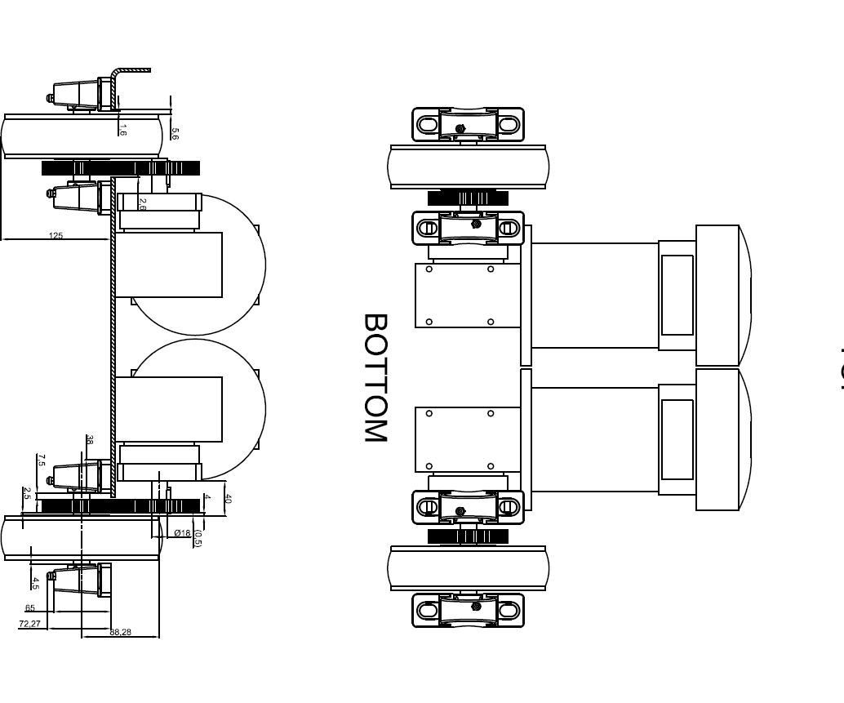
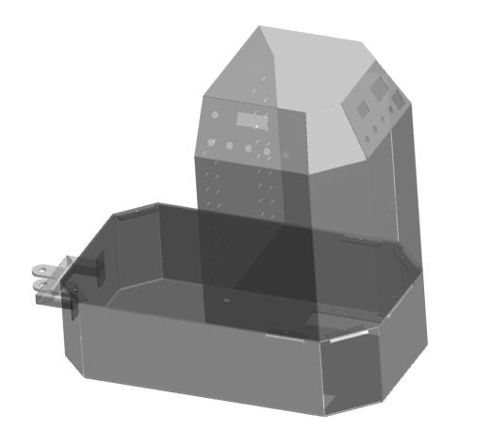
Design of the agv
The AGV design includes various convenience features such as
Axially-inverted location calling switches on either side of the AGV.
A master emergency stop button to directly cutoff power to the motor.
A 3 Position switch to easily change the mode of operation.
Differential Lighting to indicate operation, obstacles, charging.
Night mode lights, including back lit buttons and switches.

Slide 8
Sections of the proposed model
The body : The primary frame and the holding structure of the rover needs to be structurally sound and extremely rigid to handle the weights as well as to provide a protective enclosure to the sensors and driving equipment.
User interface : The microprocessor, motor driver, motor and various sensors aid in decision making and help guide the rover along the right path and towards the right destination.
The energy unit : The power distribution unit is the most essential part considering that it will have to provide the correct voltage and current to the multitude of sensors on board. It consists of the batteries which will act as power source.

Slide 9
TOOLS USED
Software
-Arduino IDE
Hardware
-Embedded Arduino Mega
-Cytron MDDS30 Motor Driver
-560W,24V,70RPM DC Motors
-LSA08 Advanced Line Following Sensor
-NRF24L01 Wireless Module
-PN532 RFID Chipset
-Joystick
-IR sensors

Slide 10
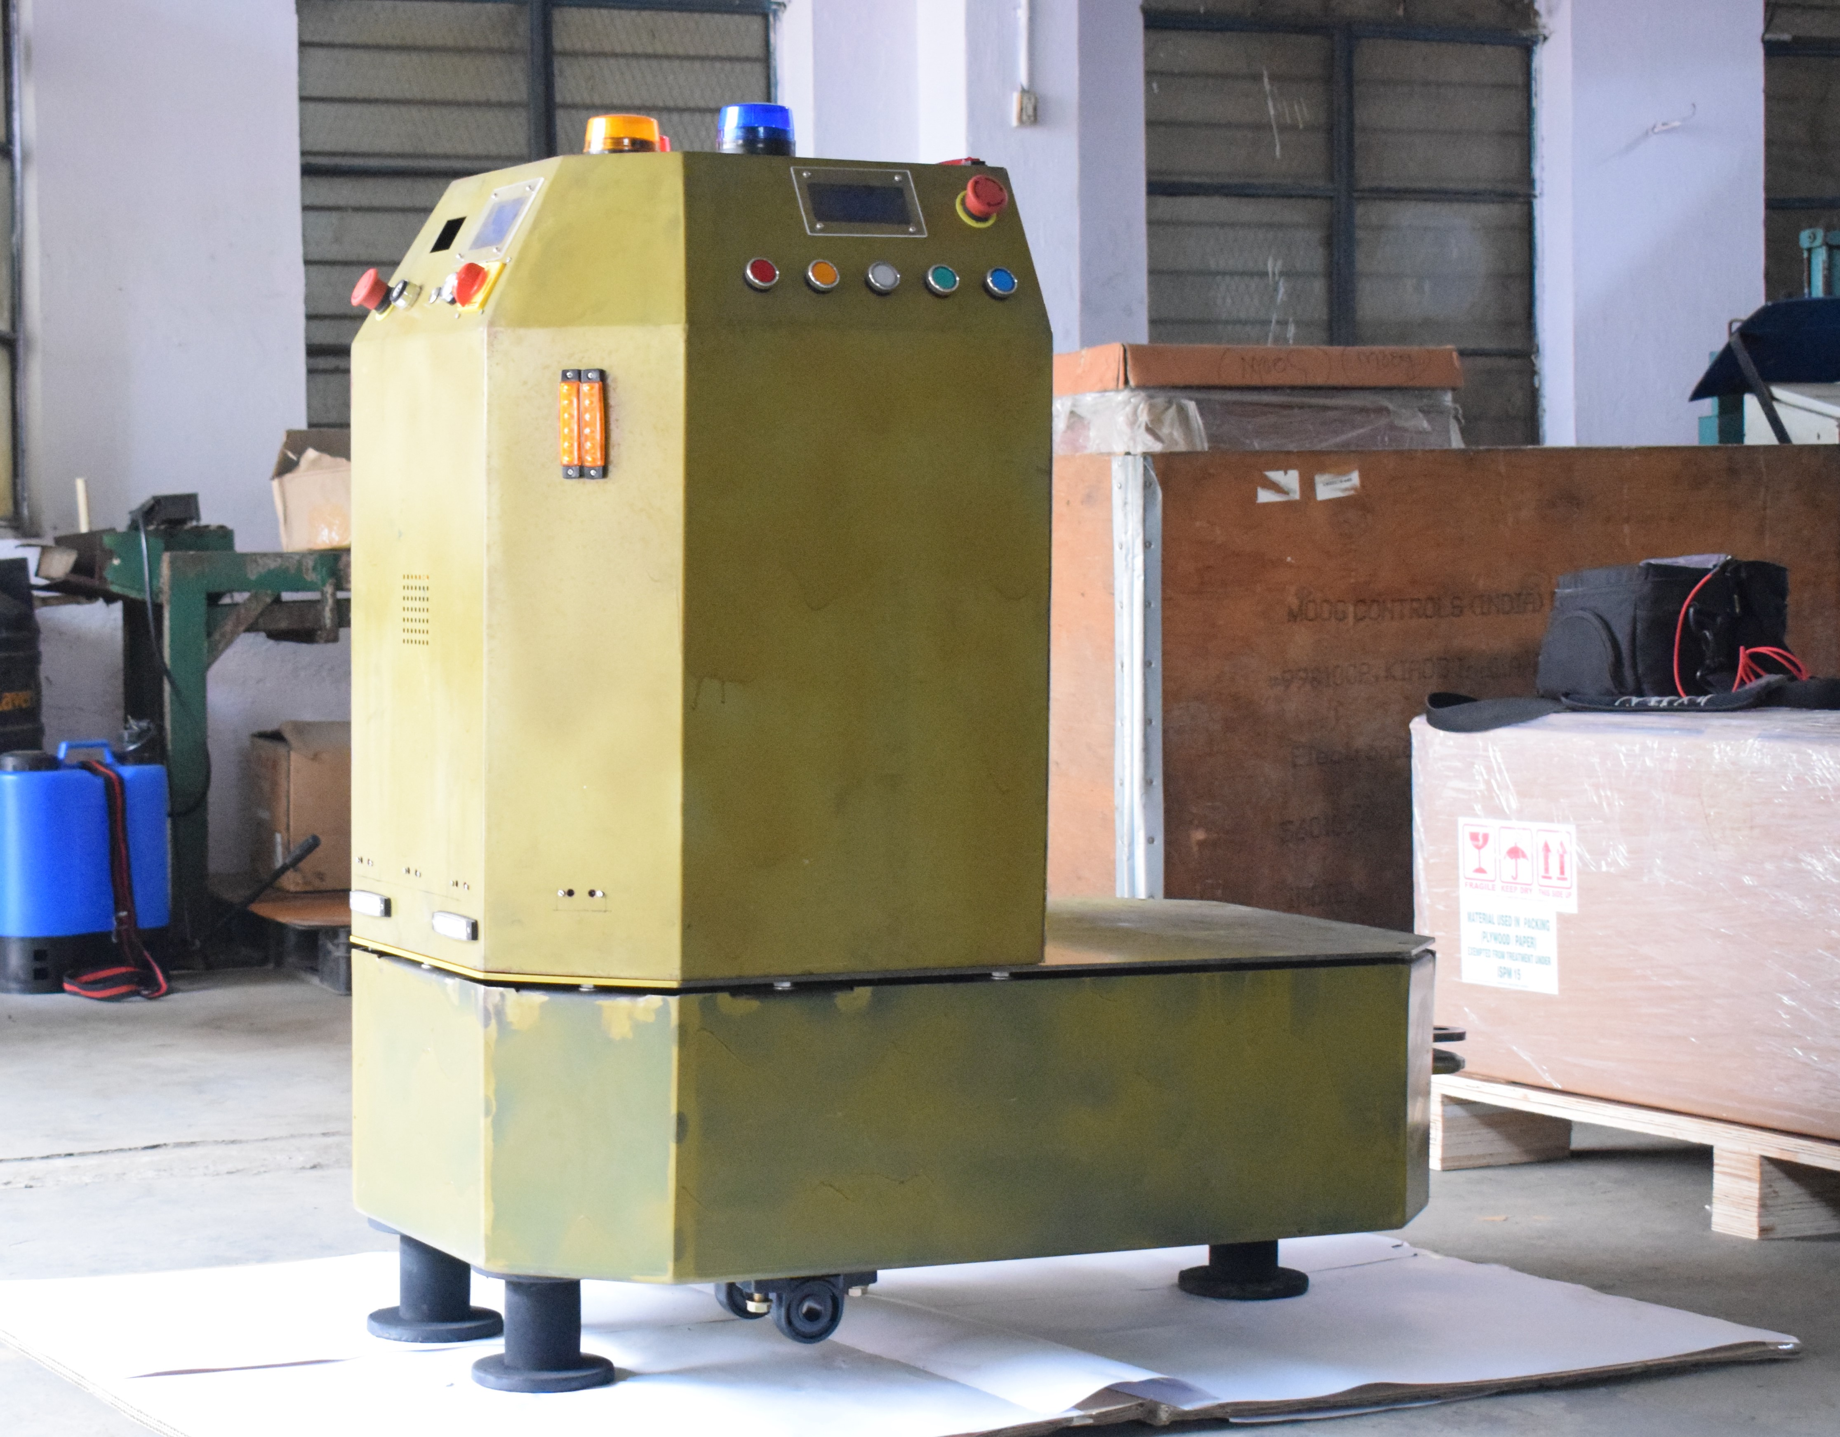
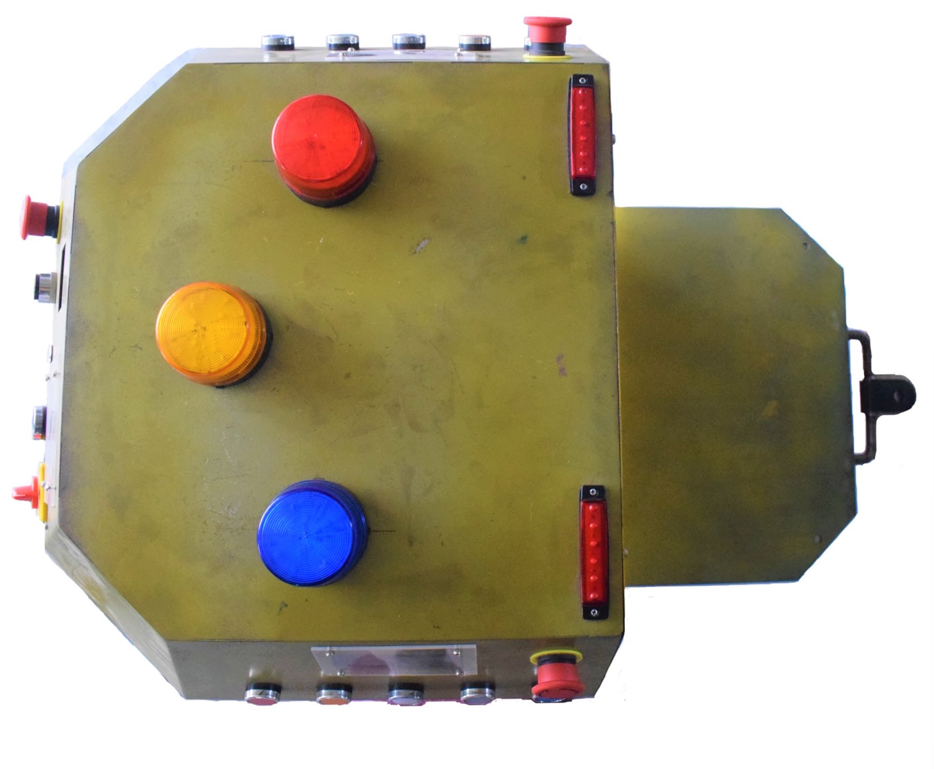
Current progress
The base prototype of the AGV has been completed.
Mechanical body with complete design features has been fabricated.
Electrical network consisting sensor nodes, voltage and current surge protection has been designed and wired.
The various functional features have been modularized and programmed.
Presently the code is being optimized and the next phase will begin shortly.

Slide 11
Thank you!

